Slide 1
Essential Dermal Fillers

Slide 2
WELCOME
Welcome to Eclipse School of Beauty & Aesthetics
Manuals & products
Toilets & exits
Lunch/breaks
Questions
Now you are here – please check in on FB @eclipsecourses

Slide 3
DERMAL FILLERS DAY 1
10am: Welcome & intro to course
10.15-12.00: Hyaluronic acid, Different filler brands and choosing the correct one, consultation process, post treatment guidelines
12.00-13.00: LUNCH
13.00 Health & safety, clinical waste and sharps, numbing protocol, first aid, anaphylaxis and EpiPen
15.00 live lip model

Slide 4
DERMAL FILLERS DAY 2
10.00-12.00: Q&A, Injection techniques theory and practical & Cheek & Chin Measuring and drawing on.
12.00-13.00: LUNCH
13.00-15.00: Practicing injections – Aspirations and Linear Threads and drawing on
15:00: Live demo.

Slide 5
DERMAL FILLERS DAY 3
10.00-12.00: Lip talk through and live demo model.
12.00-13.00: LUNCH
13.00-16.00: Lips & Cheek student models

Slide 6
DERMAL FILLERS DAY 4
10.00-12.00: Chin & Jaw filler talk through & demo
12.00-13.00: LUNCH
13.00-16.00: Chin & Jaw filler theory & live models

Slide 7
HYALURONIC ACID FILLERS
Hyaluronic acid is a substance which is naturally present in the dermis and maintains the hydration of tissues, becoming absorbed slowly over time.
Its also present in most human tissues (skin, bone, cartilage, synovial fluid, eyes, muscles, blood vessels, umbilical cord.)
It binds water molecules and hydrates (1gram HA binds 3 litres water!)
Maintenance of structure and thickness
Attracts water and nutrients in skin (intercellular transport)
HA is hydrophilic and attracts water
HA gives tissue protection, is a powerful antioxidant
Ageing causes loss of HA in skin

Slide 8
Different Filler brands
Regenovue
Lower/Mid point £35
3 products – fine plus, Deep plus, Sub-Q plus
Lidocane
E.P.Q.T
Lower/Mid price point £35
3 products – 100,300,500
Lidocaine
Revolax
Mid price point around £50
3 products -Fine, Deep, Sub-Q
Lidocaine and non lidocaine
Jeverderm
More expensive £97-£170
3 basics products ultra, ultra plus, volume.
We also have smile, ultra slime.
We have lidocaine and non lidocaine products

Slide 9
DURATION & LONGEVITY
The longevity of filler is dependent on multiple factors such as diet, lifestyle, hydration and sun exposure.
‘Normal duration’ of 8 - 12 months (average 9 months)
Duration in lips is 6 months on average because of high vascularisation and mechanical action in that area

Slide 10
THE CONSULTATION PROCESS
Personal data (name, DOB, Address)
Expectations ( setting REALISTIC expectations)
Recover/ downtime/ lifestyle ( 2 weeks healing process)
PMH (general and cosmetic)
Allergies
Risk of herpes
Estimation of amount of filler required and cost

Slide 11
Contraindications to a dermal filler treatment
.Pregnant
.Breast feeding
.Active herpes (cold sores)
.Infection on the injection sight
.History of Anaphylaxis
.Extreme lumps or bumps

Slide 12
Examples of side effects after filler
Hematoma
£
£
This is how a hematoma appears on the lip during a treatment or straight after. It will appear as a bruise and gradually increase if left untreated.
This is what will happen if a hematoma is left. This was 2 hour after the treatment

Slide 14
Swelling and bruising after filler

Slide 15
Examples of unregulated filler
This women ordered filler from amazon and injected herself and had an awful reaction.

Slide 16
Incorrect injections
When filler has been injected incorrectly there can be adverse side effects such as lumps and bumps. The only way to reverse lumps if it is after the 2 week healing process will be to dissolve the filler

Slide 17
POST TREATMENT GUIDELINES
You have undergone a dermal filler treatment where hyaluronic acid has been placed into the skin. You may initially be swollen, red and bruised, which will subside within the next 1-10days, especially if the bruising is extensive.
It is advisable that you do not touch the area for 6-8 hours
Do not apply make-up or any other cosmetics for up to approximately 6 hours
Avoid exposure to direct sunlight, UV, extreme heat i.e. sauna, steam rooms, sunbeds etc, as this may increase discomfort and swelling for 2 weeks
Avoid extreme cold; this includes ice packs that are directly applied to the skin. If necessary you can apply a cold compress to the area, to reduce any discomfort or swelling.
Arnica tablets/gels can be used to help reduce bruising or the application of vitamin K oxide cream.
If you experience any lumpiness in the area, it can be gently massaged to help smooth this out in a hot bath or shower.
You should avoid any facial massage or skin resurfacing until the area has fully healed (6 weeks)
Clean bed sheets if they will be going to bed within the next 6-8 hours

Slide 18
LUNCH

Slide 19
SALON ENVIRONMENT
Work surfaces have to be wipeable.
NO CARPETS.
Treatment couch requirements are that they are adjustable
Choose suitable disinfectant products such as Clinell
Suitable Hand wash basin requirements, Soap dispensers, Alcoholic hand rub etc

Slide 20
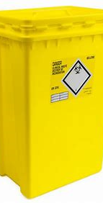
CLINICAL WASTE AND SHARPS
Hazardous waste regulation 2005
What is hazardous waste & where does it go?
Clinical waste and sharps bins.
What are sharps and where do they go?
Needle from the syringes
How do I set this up?
Contact direct 365
What happens if I don’t?
Fine

Slide 21
First Aid

Slide 22
VasoVagal or Fainting
Causes
Extreme heat
Extreme pain
Anxiety
Low blood sugar (not eaten)
Dehydrated
Standing up to quick

Slide 23
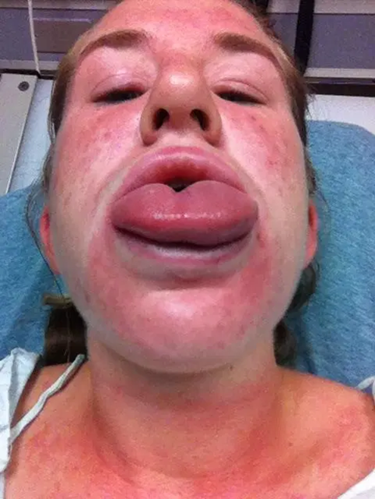
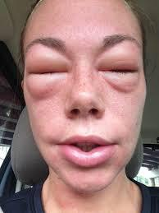
Anaphylaxis

Slide 24
Anaphylaxis
Symptoms
•Skin reactions such as itching and hives
•Flushed and pale skin
•Lower blood pressure
•Difficulty breathing
•Choking
•Weak and rapid pulse rate
•Vomiting
•Nausea
•Dizziness or fainting

Slide 25
Anaphylaxis Causes
Causes
•Exposure to an allergic substance
•Triggered by food products such as peanuts, tree nuts, fish, shellfish and milk
•Some medications including antibiotics also trigger the disease
•Stings from bees, wasps, latex are also involved
•Some sort of aerobic exercises also trigger the anaphylaxis in some people

Slide 26
EPI Pen
These effects can reverse severe low blood pressure, wheezing, severe skin itching, hives, and other symptoms of an allergic reaction.
EpiPen is injected into the skin or muscle of your outer thigh. In an emergency, this injection can be given through your clothing.
Do not use the EpiPen if it has changed colours or has any particles in it, or if the expiration date on the label has passed.

Slide 27
How to use an Epi Pen
. Call 999
.Explain to the operator on the phone the symptoms of your client
they will confirm that they can use the epi pen.
.The operator will talk you through how to use.
. Inject the epi pen into the leg muscle.
.wait and hold for 10 down for seconds
.if there isn’t instant relief then a 2nd auto injector may need to be used.

Slide 28
Steiner Line

Slide 30
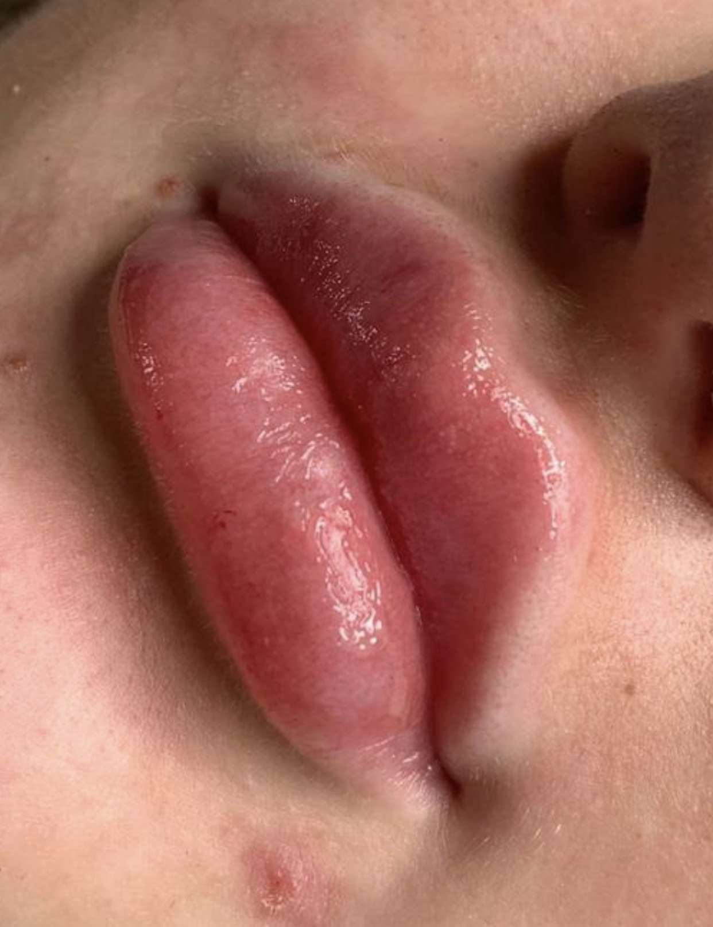
Students work
Filler queen by Rebecca
Prettylittlefaces_x by Rai

Slide 31
Student work
Spmubyeva

Slide 32
Student Work
Enhanced.aestheticsxx
Inject_with_love

Slide 33
Day 2 Dermal Fillers

Slide 34
INJECTION TECHNIQUES
Retrograde Linear thread
We inject 1 bar or 0.1 at a time.
We have 9 injections all together.

Slide 36
Safe lip injections
If you can clearly see an artery in the lip. Or any kind of blood supply. Avoid that area at all costs. Move slightly and where possible always inject perpendicular to that artery so you have less chance of cannulating it.
You must stay in the pink.
You must stay in the dry (not just the entry but the entire needle)
You must stay superficial. But not so superficial you can see the colour of the needle
Use good quality products that are well known and well used.
If you use awful products that have no history. It may well be that they do not dissolve properly.
If you use a new product make sure it dissolves in a saucer or petri dish with hyalase.

Slide 37
vascular occlusion
A vascular occlusion occurs when blood is no longer able to pass through a blood vessel.
It may be a complete occlusion or partial occlusion, resulting in a diminished blood supply.
When there is a VO there will be paleness or a discolouration that is abnormal.

Slide 38
Vascular Occlusion
Diagnosis
Any sign of a lack of blood supply returning to an area is a negative sign.
Use cap refill to check thoroughly at all times before and after treatment. This usually presents in the form of blanching or paleness
If something goes very blue very quickly.
This can be venal occlusion. (Blocked vein)
There are two very different treatments for venal and arterial
Cold for venal. Hot for arterial.
You should always have:
- Viagra.
- Aspirin
- Epipen
- Heat packs

Slide 39
Necrosis
Necrosis is the death of body tissue. It occurs when too little blood flows to the tissue.
Signs of impending necrosis include pain, prolonged blanching and coolness of the skin.
Necrosis cannot be reversed
Undiagnosed VO which lead to a Necrosis

Slide 40
C.R.T
This stands for Capillaries Refill Timings which indicates how long it can take for the capillary to refill with blood after presser has been applied.
In most people its 3 seconds or less if they are under the age of 65.
When we are doing a lip treatment we need to a CRT before AND after the treatment.
When you do this you can COMPARE time taken.
If there is a delay of 3 or 5 seconds greater than the original timing this could indicate a blocked or partially blocked which could mean a VO.

Slide 41
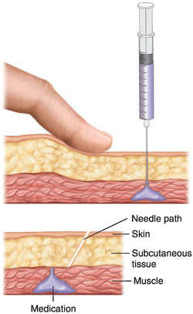
Aspirations

Slide 42
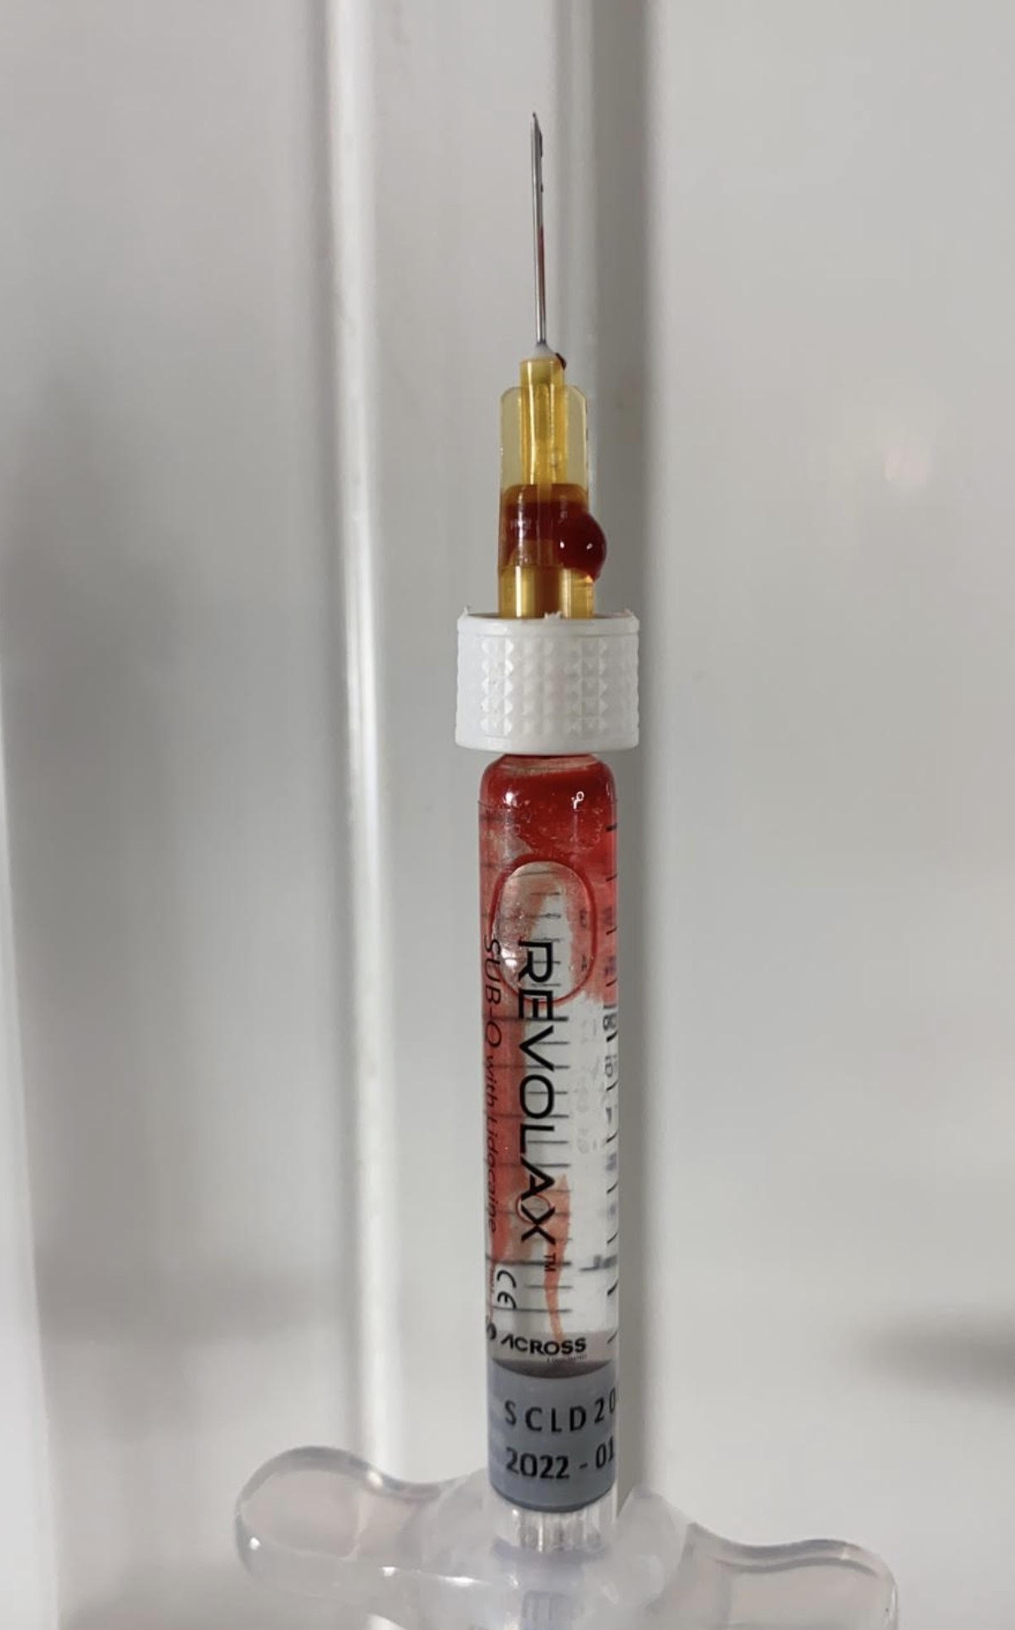
Positive aspiration
When we do aspirations we have the ability to see if we are in a vessel.
We go down to the bone and pull back on the plunger and have that is an example of a positive aspiration or flashback.
By doing this we are creating SAFER injection techniques however they are always correct.
We can get false positive and false negatives aspirations.
Negative aspirations
A negative aspiration would have no blood or flashback.

Slide 43
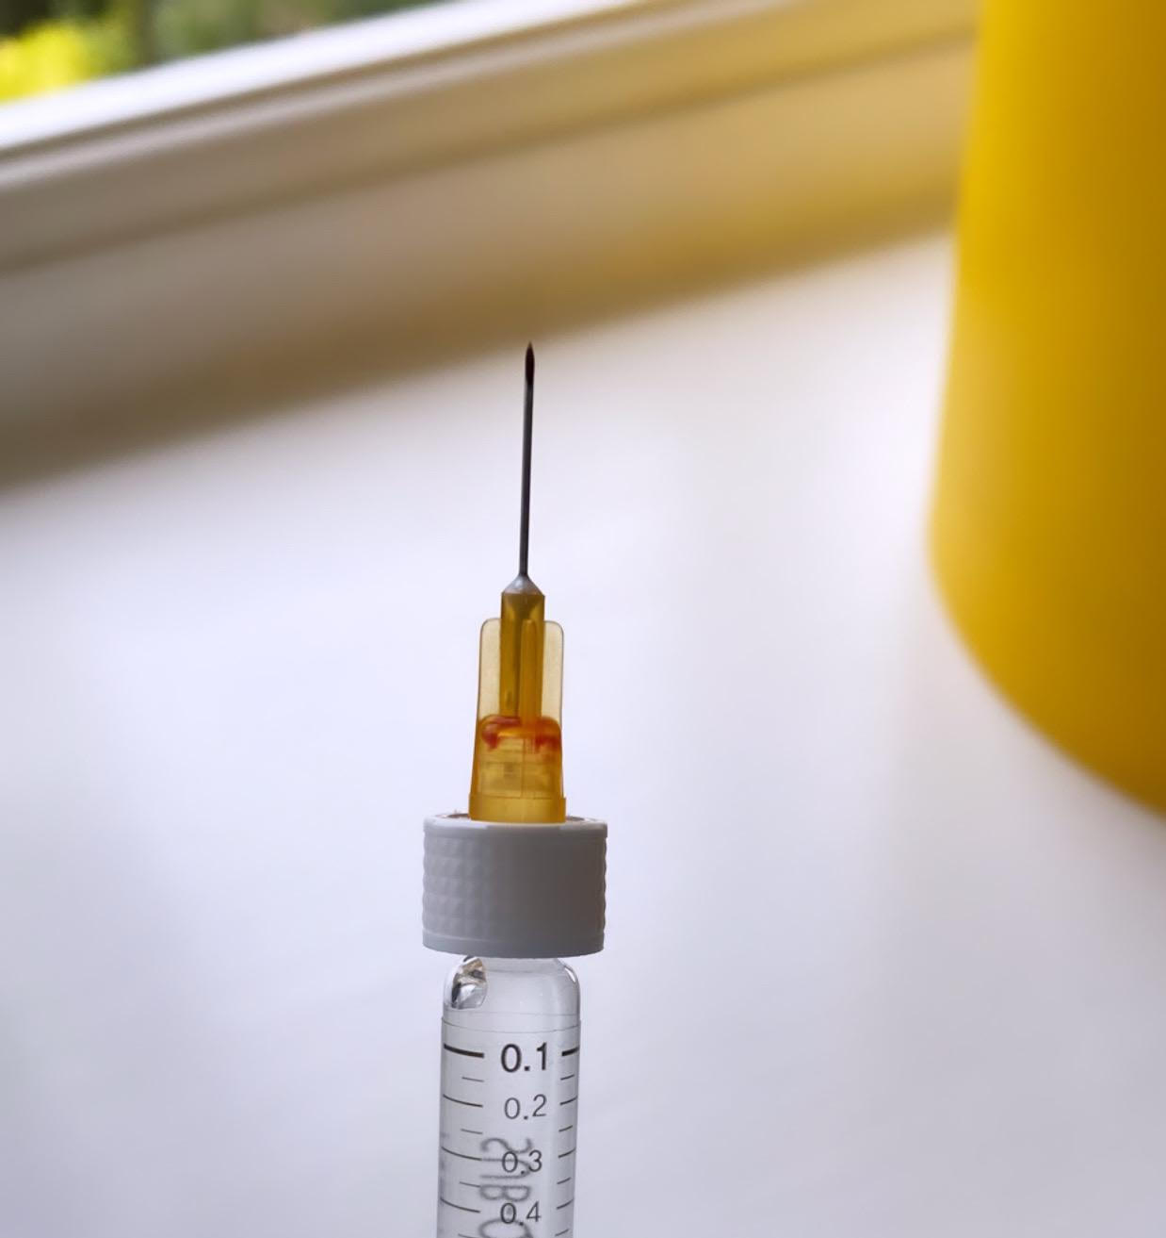

Slide 44
LUNCH

Slide 45
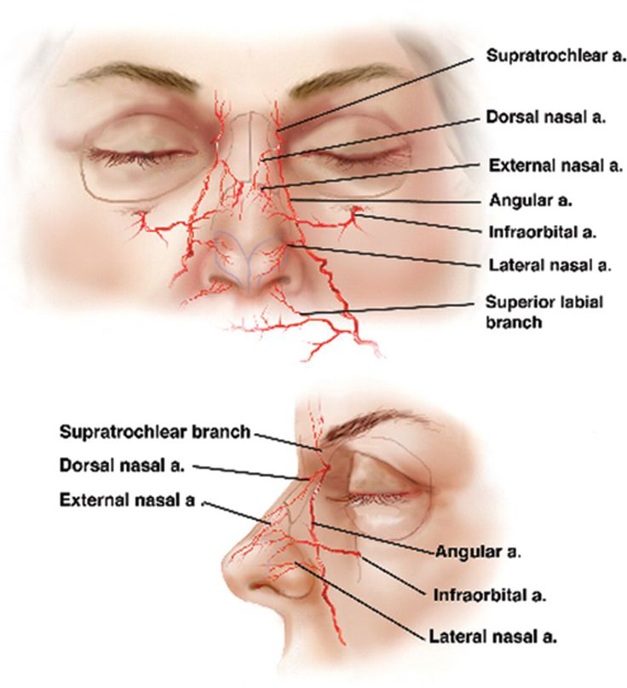

Slide 46
Day 3 Dermal Fillers

Slide 47
Day 4 Dermal Fillers

Slide 48
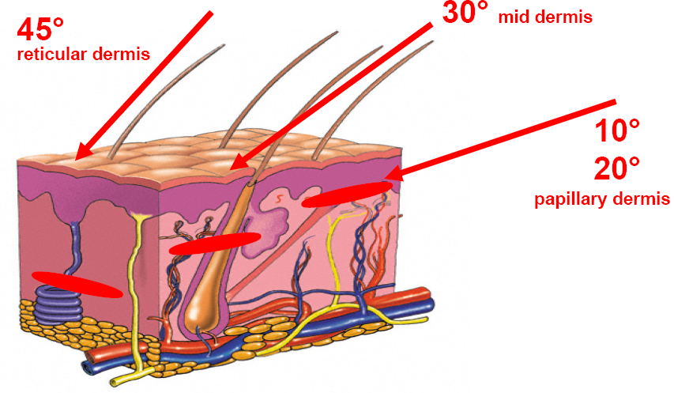

Slide 49
